Slide 1
WELCOME TO
UNIFIED TECHNOLOGY LEARNING PLATFORM

Slide 2
DREAM CRUSHES
SUNITHA
JAISHREE
KARTHIKEYAN
ILAKIYASREE

Slide 3
LEARNING AID

Slide 4
CONTENTS
INTRODUCTION
REQUIREMENTS
ABSTRACT
WORKING PROCEDURE
CONCLUSION

Slide 5
INTRODUCTION
Learning aid is a game of self analysis program wherein a person’s intellectual talent is tested.
It is a single player game.

Slide 6
OBJECTIVE:
1. To analyze the stress level of the student
2. To analyze the difficulties faced by the
student.
3. To analyze the perception of thinking
4. To detect the IQ level of the students
5. To identify their area of interest

Slide 7
WORKING PROCEDURE
Here we have used clcd display and glcd for giving the input and producing the output.
It is a simple game where a picture is displayed on the glcd and a logical question is asked based on the picture .

Slide 8
In the same basis a series of questions is asked for testing the IQ level of the person concerned.
At the end ,the total score of the person is displayed.
This score helps the viewer to judge the person’s level of thinking.
The questions asked here are designed in such a way that they act as a aid in the field of medicine.

Slide 9
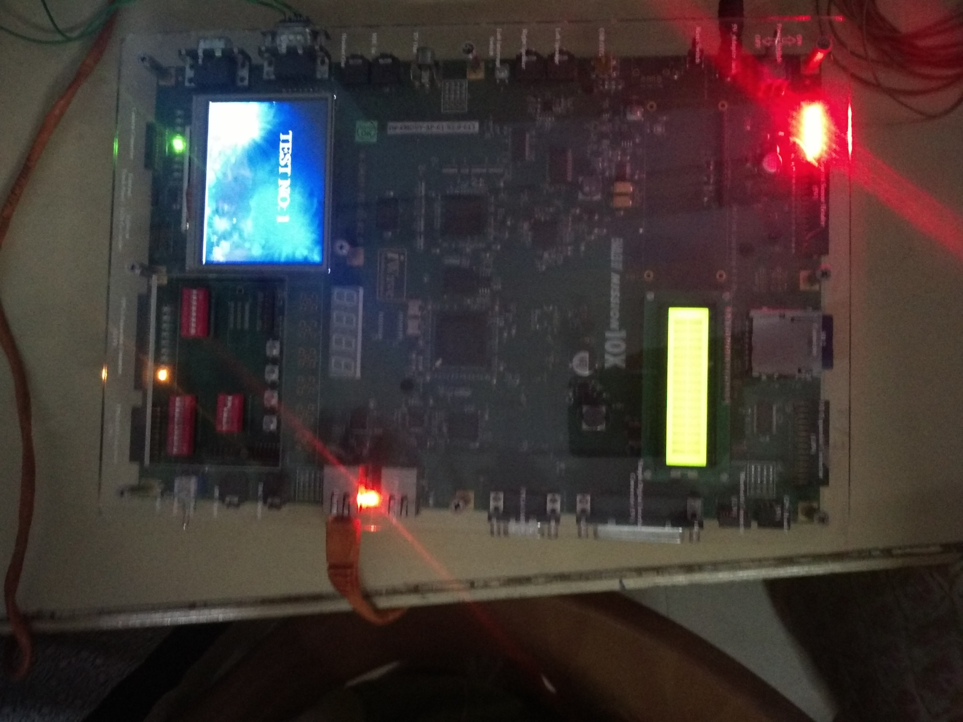

Slide 10
CONCLUSION
When this project is developed as product this can be used for dual purpose. It can either be used for Gaming or for intellectual tests. This product can be easily marketed by interfacing Arduino and GLCD. Thus becomes user friendly.

Slide 11
THANK YOU

